Slide 1

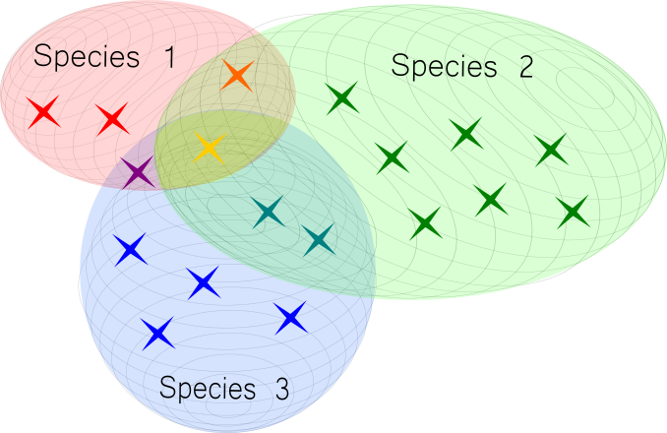
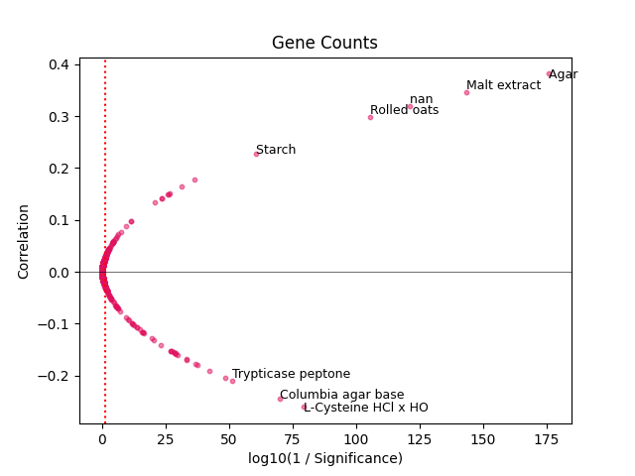
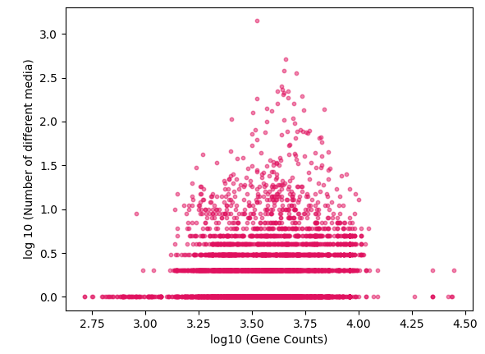
Quantifying the prokaryotic resource niche
Department of Life Sciences, Imperial College London, UK
Author: Dhylan Patel
Fig 3: Relationship between log10(1/significance) and correlation coefficient for ingredient per gene count. Labels = Highly significant correlations, dotted red line = 5% significance level, solid black line = no correlation.
Fig 1: Illustration of niche width (coloured circles) and niche overlap for resource requirements (x).
Methods
Create a combined dataset of prokaryotes and their a) optimal growth media (b) optimal ingredient requirements (c) Intrinsic characteristics, via REST API calls to the NCBI and DSMZ.
Perform niche width analysis using the number of optimal media against the four intrinsic characteristics.
Analyze correlations for intrinsic characteristics and ingredient requirements using spearman’s ranked correlation coefficient
Hypothesis
More genes (larger genomes) need more nitrogen and phosphorus resources³ for DNA replication, reducing the number of suitable growth media (niche width).
Fewer genes limit the enzyme repertoire for resource conversion, reducing the number of suitable growth media.
Species relatedness dictates patterns of resource niche overlap in prokaryotes.
Background
The ecological resource niche is the set of resources an organism requires for growth within its environment (fig 1). It can be observed by studying media recipes used to culture prokaryotes for optimal growth.
Expanding on KOMODO¹, the MediaDive database² from DSMZ standardizes media recipes with the microbes able to grow on them.
There is a limited understanding of how the fundamental niche (comprising intrinsic characteristics) effects the realised prokaryotic resource niche.
Preliminary Insights
Next Steps
Fig 2: Relationship between log10 scaled genome size and log scaled niche width (denoted by number of different media). Discrete values on the y-axis are caused by log scaling for lower values.
Microbes will fall into set life history strategies due to evolutionary trade-offs⁴.
Investigate whether resource niche clustering occurs based on life-history strategies using PCA.
Determine phylogenetic causes for the relationships involved.
Objectives
References
Oberhardt, M.A et al. 2015. Harnessing the landscape of microbial culture media to predict new organism–media pairings. Nat Commun 6, 8493. https://doi.org/10.1038/ncomms9493
Koblitz, J., Halama, et al. 2023. MediaDive: the expert-curated cultivation media database. Nucleic Acids Res 51, D1531–D1538. https://doi.org/10.1093/nar/gkac803
Li, J., Mau, et al. 2019. Predictive genomic traits for bacterial growth in culture versus actual growth in soil. ISME J 13, 2162–2172.
Malik, A.A et al. 2020. Defining trait-based microbial strategies with consequences for soil carbon cycling under climate change. The ISME Journal 14, 1–9. https://doi.org/10.1038/s41396-019-0510-0
Create a unified framework linking species to their optimal resource media and constituent ingredient requirements.
For intrinsic characteristics: organism genome size, organism GC content, number of genes and number of protein coding genes, are there correlations with niche width and ingredient requirements?
Notes:
Background ( 1 min)
My poster is focused on quantifying the prokaryotic niche. To achieve, this we must first examine the concept of a niche.
Niche = Function of an organism in its habitat.
There are two further categories within this.
Fundamental = Intrinsic characteristics of an organism encoded in the genome such as organism complexity.
Realised = Actual function and expression of genome. Can be represented by growth medium preference and resource requirements.
Figure 1 demonstrates it. This depicts how different species may have different niche widths depending on how many resources they may grow on. Niche overlap occurs where certain resources are shared between multiple species.
The broad goals of this study are to improve the process of designing media recipes for individual prokaryotes, improving prebiotic design for whole microbiomes and understanding the different resource metabolism strategies.
Hypothesis (30 secs)
It is expected that the fundamental niche will influence the realised niche by imposing resource requirements due to complexity.
A larger genome requires more nitrogen and phosphorus during DNA replication and may therefore have a greater resource abundance requirement. However, this limits the number of recognised laboratory media available to support growth.
On the other end of this scale, smaller genomes have a limited enzymatic repertoire. This may limit the organism’s ability to metabolise certain environmental substrates.
Due to these reasons, highly complex and highly simple organisms will have more limited resource niche widths (with reference to figure 1).
Objectives (30 secs)
The study aims to delineate how the realised resource niche is shaped by the fundamental niche (characterised by prokaryotic complexity). This is measured across gene count, protein encoding genes, and genome size. (and GC content).
In order to achieve this preliminary objective, a unified database must be created to list each prokaryote, its optimal growth media and subsequent resource requirements.
Methods ( 1 min)
To create this database, the DSMZ MediaDive database was accessed online through a python script which made API calls to access growth media recipes as well as the taxa which grew optimally on each medium.
This allowed the collection of a prokaryotic database which catalogued each organism by the different media it could grow on and the maximum resource dependencies.
Following this, niche width analysis was performed (to produce figure 2) and ingredient correlation analysis was performed (to produce figure 3).
Preliminary Insights (1 min)
Figure 2 displays each organism’s log scaled gene count against its log scaled resource niche width (indicated by the number of growth media it could grow on).
This resulted in a slight normal distribution as depicted.
The majority of taxa were only able to be cultured on one growth medium optimally, however, those that could be cultured on more than one tended to be centrally clustered. This indicates that the limitations imposed by genome size may indeed have affected the distribution.
There does appear to be discrete bands occurring due to the number of different media, however, these are a result of the log scaling effect which makes the distances between small values appear greater than on a linear scale.
Figure 3 highlights the individual ingredient resource dependencies per organism correlated against gene counts.
Correlation tests were taken and the spearman ranked correlation coefficient between ingredient abundance and gene count, is displayed.
Evidently, ingredients to the right of the red dotted line are significantly correlated, with the strongest correlations being labelled.
Next Steps (1 min)
A clear next step, would be to distinguish if there are any commonalities between the ingredients which were extremely positively correlated with organism complexity (versus the ingredients which were extremely negatively correlated).
Due to the many ingredients categorised in the dataframe, there is an opportunity to reduce the dimensionality of the data through PCA analysis. This marks a next step in the procedure where I hope to expand the scope of the study to observing the clustering patterns of the resource niche.
From this, there may be opportunities to determine whether clustering is based on phylogenetic relationships or life-history strategies of prokaryotes (ie: the specific roles prokaryotes play in their ecosystems - for instance optimisation for rapid growth, motility optimisation for scavenging).
Thank you for listening and I welcome any questions.

